Slide 1
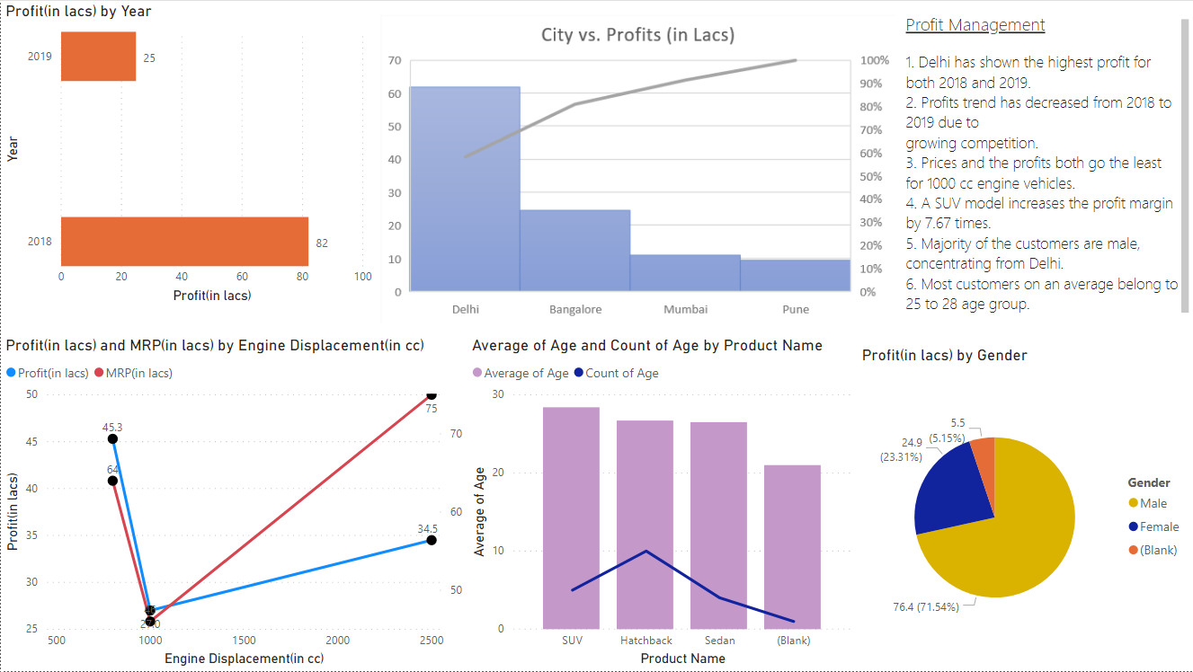
Profit Management Dashboard

Slide 2
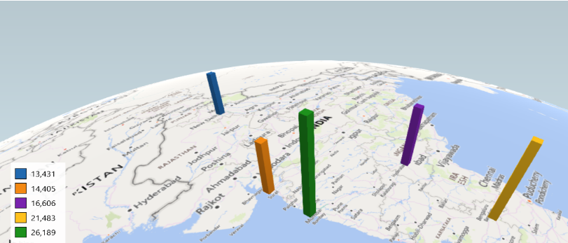
Notes:
Mumbai produces the highest market contribution (overall) followed by Bangalore.
Mumbai has the highest population but follows 2nd in Per capita Income.
Best market is available in cities of Mumbai and Bangalore followed by Hyderabad.
The 5 cities showing potential – Mumbai, Bangalore, Hyderabad, Surat and Delhi.
City | Population(Mill) | Per Capita Income | Market Contribution
Mumbai | 12.4 | 12800 | 26189
Bangalore | 8.4 | 15500 | 21483
Hyderabad | 6.8 | 14800 | 16606
Surat | 4.5 | 19400 | 14405
Delhi | 11 | 7400 | 13431
*Calculated using Market Share of 16.5% (optimum)

Slide 3
Identifying the Incentive Budget
Approx price for Electra is INR 15 Lacs |  |  |  |  | ALL Costs are in INR
Exhibit A: Payment Curve
Rank | %Commission
1 | 2%
2 | 1.50%
3 | 1%
4 | 0.50%
5 | 0.25%
Exhibit B: Q1'2021 Car Sales Estimation by Representative
Car price | 15,00,000 |  |  |  | Quarterly | Annually
City ABC | Estimated Car Sales (Units) | Rank | Car sale amount | Incentive in % | Incentive amount
Rep A | 8 | 4 | 12000000 | 0.50% | 60,000
Rep B | 11 | 2 | 16500000 | 1.50% | 2,47,500
Rep C | 9 | 3 | 13500000 | 1.00% | 1,35,000
Rep D | 12 | 1 | 18000000 | 2.00% | 3,60,000
Rep E | 7 | 5 | 10500000 | 0.25% | 26,250
Ans. 4.2 (a) |  |  |  |  | INR. 8,28,750
City XYZ | Estimated Car Sales (Units) | Rank | Car sale amount | Incentive in % | Incentive amount
Rep F | 3 | 4 | 4500000 | 0.50% | 22,500
Rep B | 2 | 5 | 3000000 | 0.25% | 7,500
Rep G | 4 | 3 | 6000000 | 1.00% | 60,000
Rep H | 5 | 2 | 7500000 | 1.50% | 1,12,500
Rep I | 7 | 1 | 10500000 | 2.00% | 2,10,000
Ans. 4.2 (a) |  |  |  |  | INR. 4,12,500
Average incentive per store |  |  |  |  | 6,20,625 | 24,82,500
Total incentive for 5 stores for the quarter |  |  |  |  | 31,03,125 | 1,24,12,500
Ans. 4.2 (b) Total incentive budget for all store for 2021 (All four quarters) |  |  |  |  | INR. 1,24,12,500.00 | -

Slide 4
Ways to avoid drawbacks of the current compensation plan:
Motivation – Lead to work forward in a collective fashion towards a common goal.
Team-Building – Relying on other’s skills and contributions, a spirit of teamwork
Positive Peer Pressure (3P’s) – Ambitious workers might encourage greater level of participation from others.
Increased Earning – Synergic team work can result in higher quality and productivity.
Transportation – Road/Rail/Air connectivity
Regional and Central Govt. Policies – Banking Facilities/loans and bonds
Investment Climate – Economical, Financial and socio-political conditions
Literacy Rate – Availability of skilled staff
Geographical Factors
Climate Conditions
Tech and Power – To use techs and turn resources to assets
Drawbacks of current compensation plan:
Built-in Limitations – Incentives lose effectiveness overtime and does not ensure improvement in quality.
Resentment – Incentives which seem unfair can undermine teamwork and also undermine the company goals.
Manipulation – Metric which effects incentives the most will get the most attention which may or may not be in the best interest of the company.
Management – Discontinuation of incentives might pose difficulties for the managerial bodies.
Health Issues – To increase their earnings through incentive schemes, work hours increase leading to health issues.

Slide 5

Q2. Analysis & Take away
Section 2: Analysis & Take away
Weighted scoring shows a prioritization framework designed to help you decide how to prioritize features and other initiatives
With this framework, initiatives are scored according to set of common criteria on a cost vs. benefit basis and then ranked by their final scores to derive an objective, quantitative business value.
We can use this to determine the key cities on our roadmap
Deciding which feature/product to work on first, expenditure of the shares of development resources and identifying the target consumers.
Besides relying on limited parameters, it is crucial to add other pertinent parameters.
There should be a group based incentive program rather than personal incentive program.

